Slide 1
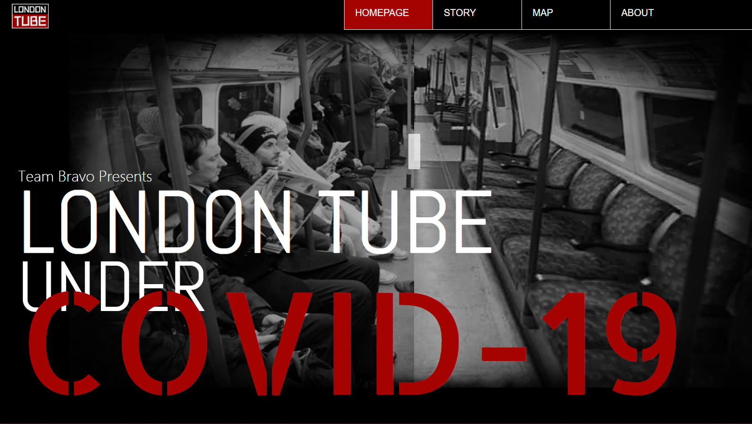

Slide 2

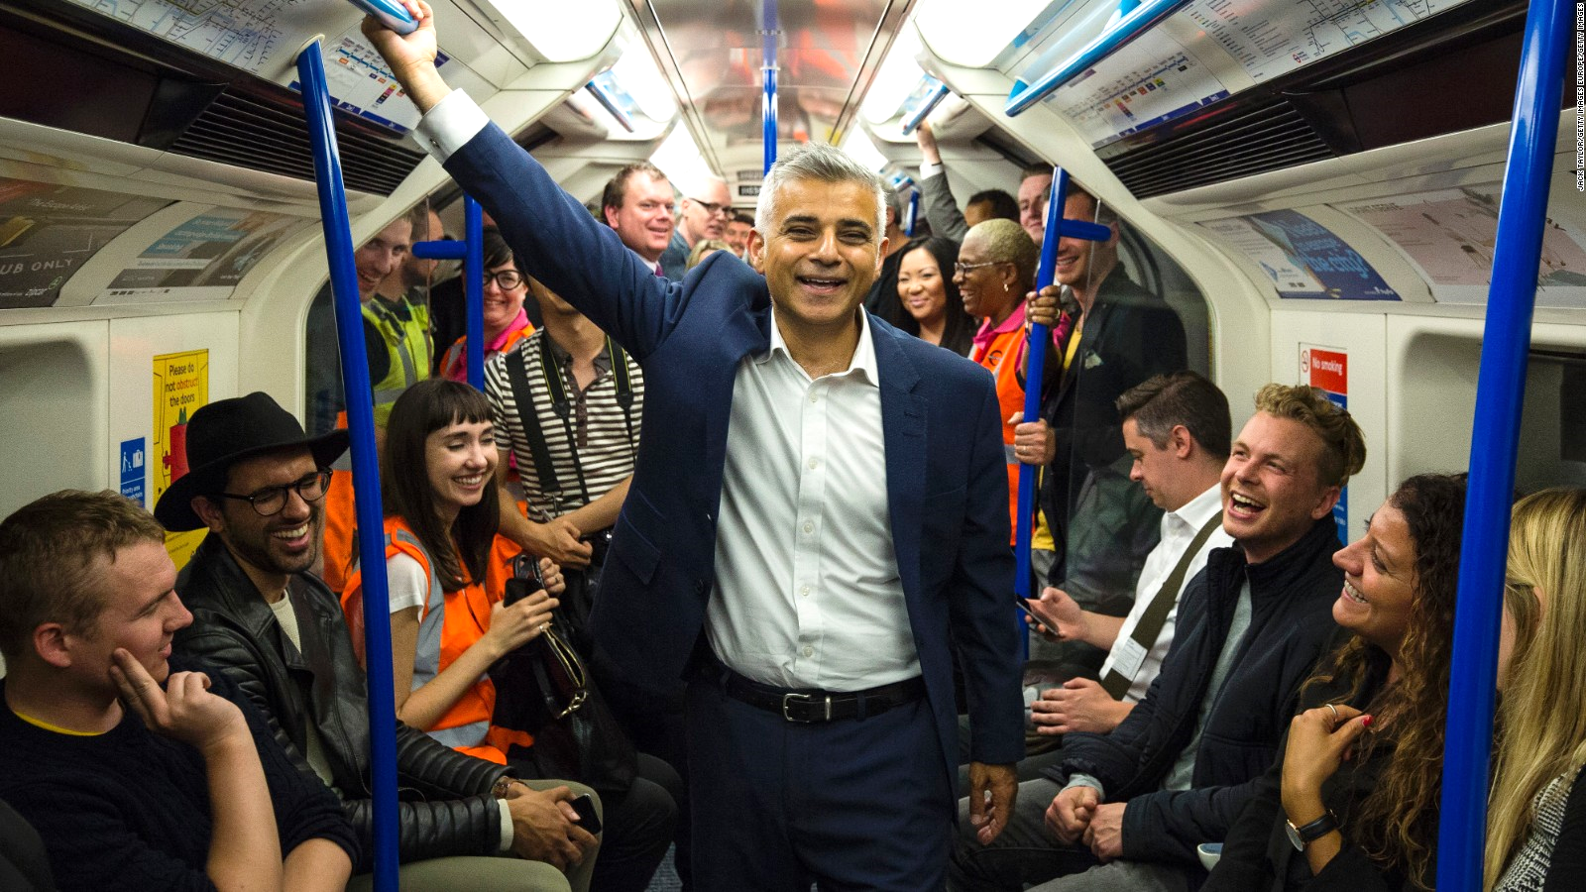
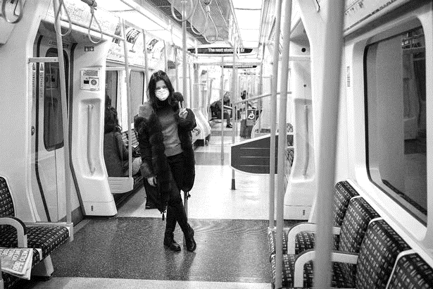
INTRODUCTION
UNDER CONVID-19
Background
"At the height of rush hour, people on the London Underground usually say 'excuse me’.”
Dave Barry
Now we dont't have to, since there is no more rush hour.
Notes:
P1
“At the height of rush hour, people on the London Underground usually say ‘excuse me’.” Dave Barry once said.
But now we dont't have to, since there is no more rush hour.

Slide 3
INTRODUCTION
UNDER CONVID-19
Background
The Underground is one of the most widely used forms of public transportation in London. However, Since the outbreak of the COVID-19, remarkable modal shifts away from public transport, especially the underground, to active and car-dependent transport were reported. Experts estimated that, In light of restrictions on travel methods and social distancing policies, reduced operation of the London Underground and railway services contributed to a reducing daily trips.
Notes:
P2
The Underground is one of the most widely used forms of public transportation in London. However, Since the outbreak of the COVID-19, remarkable modal shifts away from public transport, especially the underground, to active and car-dependent transport were reported. experts estimated that, reduced operation of the London Underground and railway services contributed to a reducing daily trip.
Thus our story begins…

Slide 4
INTRODUCTION
UNDER CONVID-19
Aim of study
The results of our analysis and visualizations seen on the website show how the London Underground traffic patterns change over time before and during the COVID-19;
Through investigating the change in daily station entry/exit counts over time, we conclude new temporal characteristics in the flow at different metro stations under the COVID-19;
Better off we want to provide local government and related industries with a reference about COVID-19’s impact on the London Underground to optimize the operation of the London Underground during the pandemic.
Notes:
P3
with our analysis we want to demonstrate how the London Underground traffic patterns change over time before and during the COVID-19;
We want to conclude new temporal characteristics in the flow at different metro stations under the COVID-19;
And Hopefully ,we want to help government and related industries to optimize the operation of the London Underground during the pandemic.

Slide 5
Web Design
UNDER CONVID-19
What do we want? Why do we want?
An INTERACTIVE MAP that can help us explore:
TIME SCALE: To show the traffic changes before and during the pandemic
CITY LEVEL: To show the London Underground traffic flows and patterns distribution
STATION LEVEL: to show the specific changes in yearly, daily, and hourly usage
Does the usage patterns really change regarding relevant polices and measures?
How should we avoid the “peak hour”?
Different Regions (Stations);
Different Weekdays;
Different Time Period.
Notes:
The result shows how the London Underground traffic profiles change over time before and during the COVID-19;

Slide 6
Web Design
UNDER CONVID-19
What do we need? How do we do?
Data (spatial attributes of London underground lines, stations and usage);
Statistical analysis to show the overall trend;
Clustering analysis to identify the usage pattern.
Statistical plots to represent flow and pattern changes;
Station size to represent traffic flows;
Station color to represent traffic patterns;
Line charts to show the details on flow changes;
Options to choose different conditions: year, weekday, time period, and inbound or outbound.

Slide 7
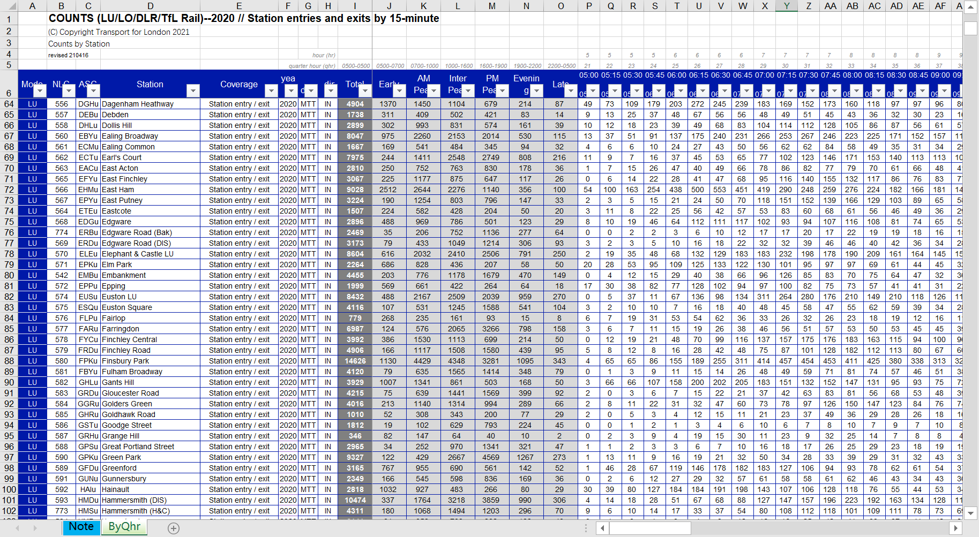
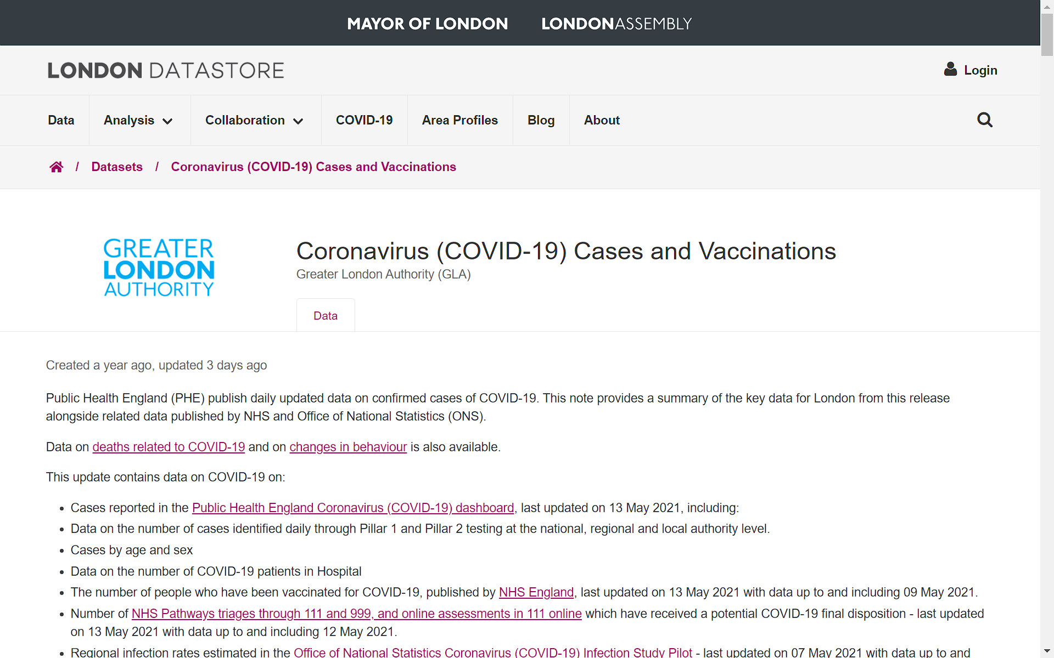
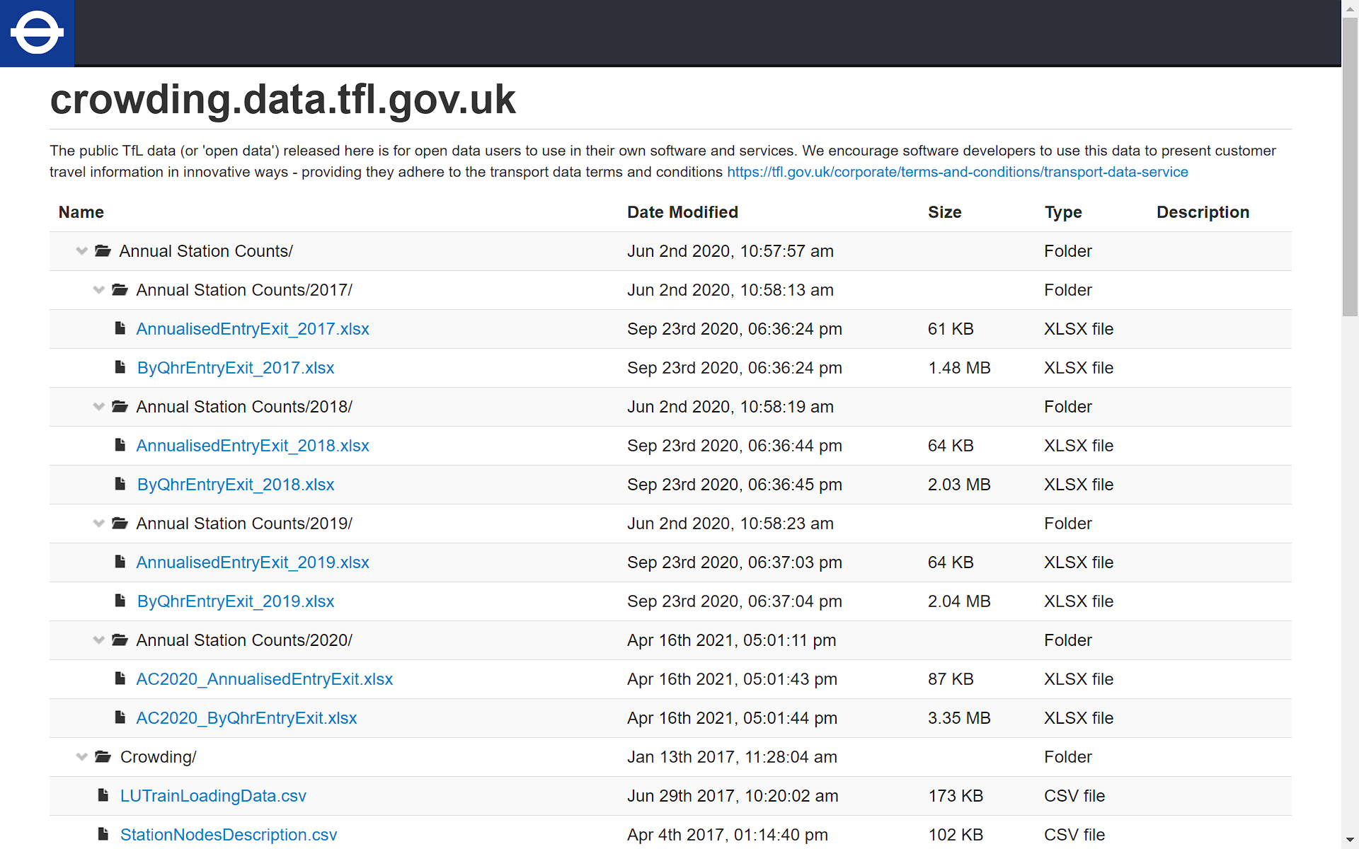
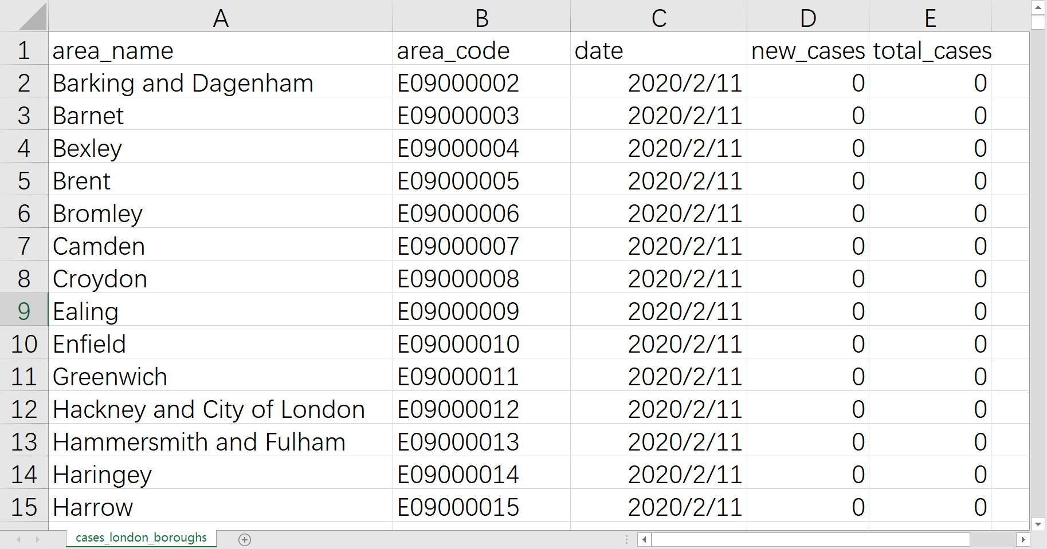
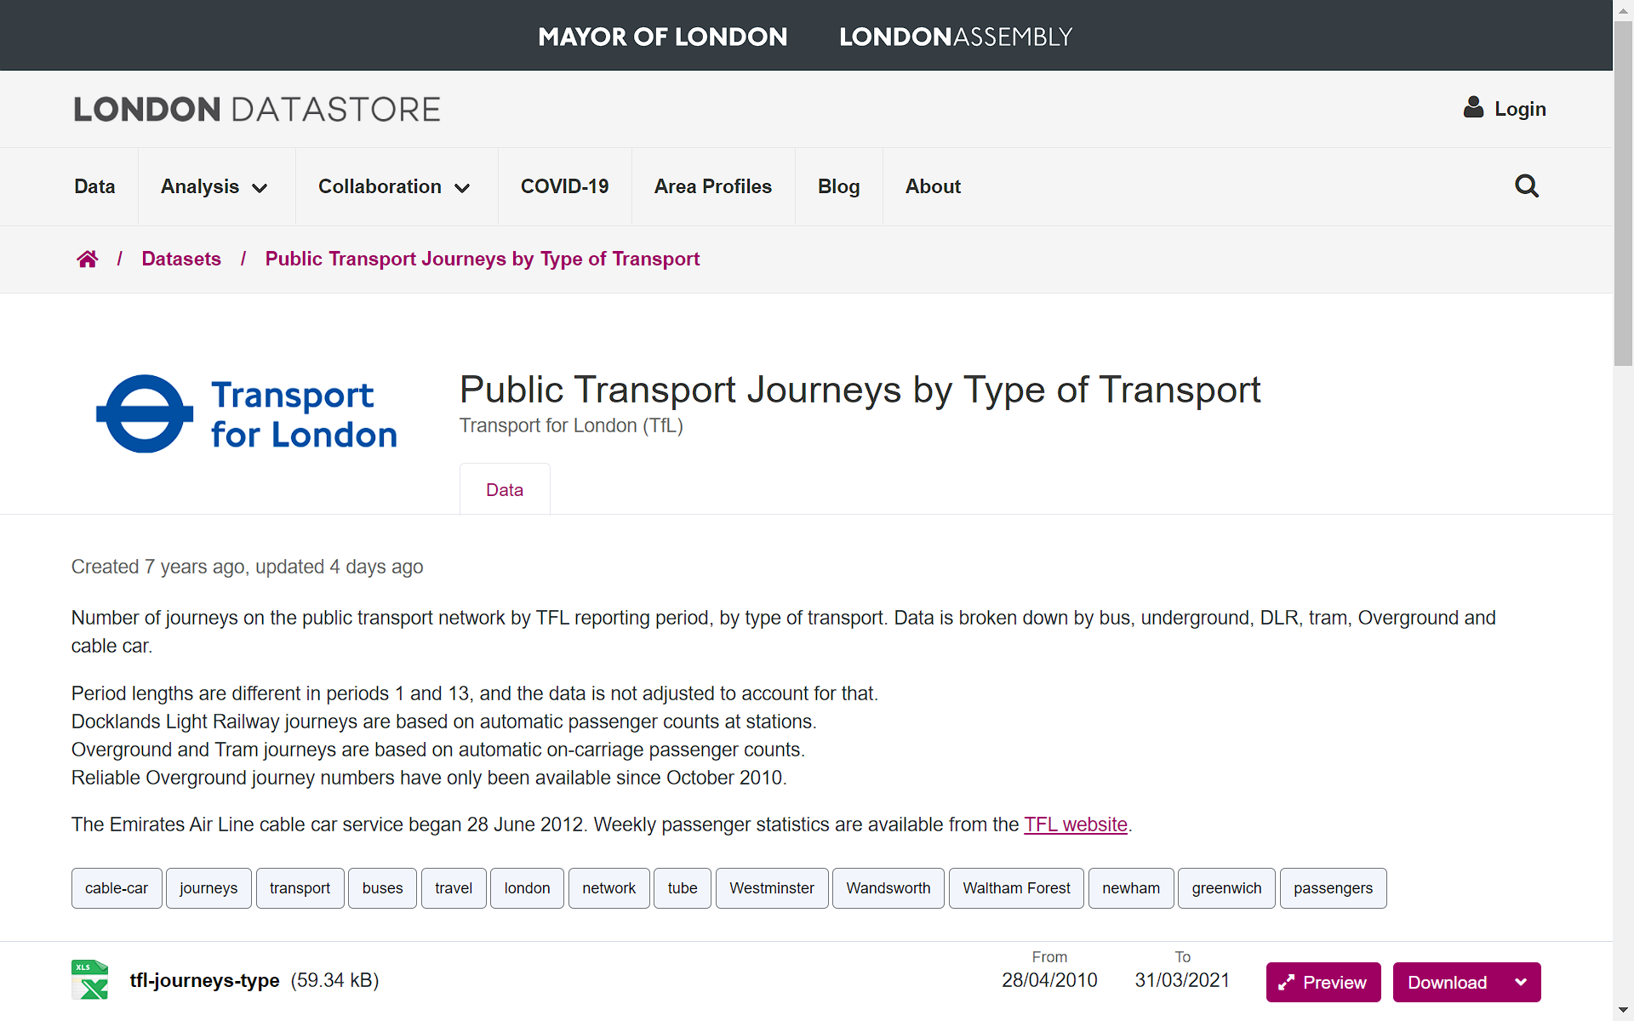
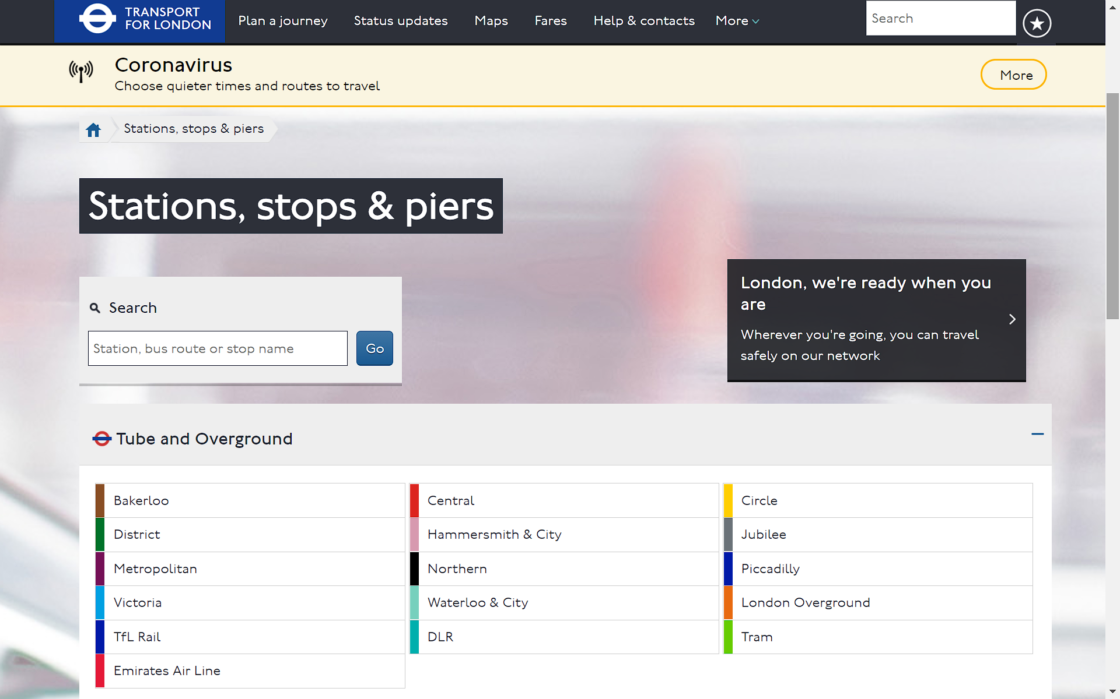
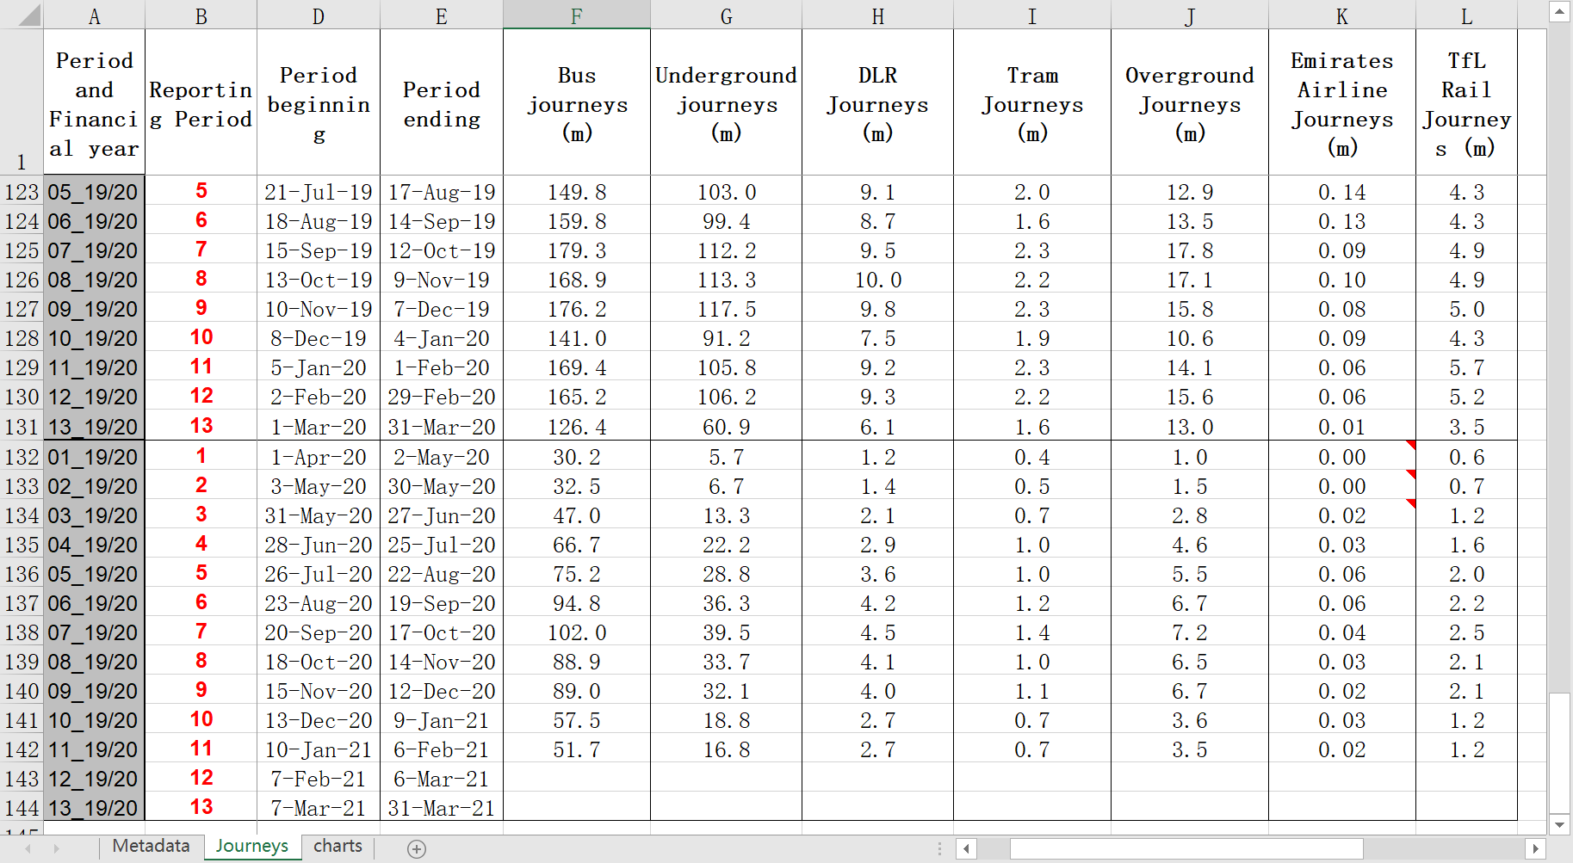
DATA
UNDER CONVID-19
Statistical Data
Annual station counts (TFL)
http://crowding.data.tfl.gov.uk/
Station and Tube Line Names (TFL)
https://tfl.gov.uk/travel-information/stations-stops-and-piers/
Public Transport Journeys by Type of Transport (GLA)
https://data.london.gov.uk/dataset/london-borough-profiles
Coronavirus Cases and Vaccinations (GLA)
https://data.london.gov.uk/dataset/coronavirus--covid-19--cases
Notes:
AS for the data source：
We have the statistical data including Annual Metro Station journey counts from TFL, and the formal station and tube line names from tfl website, and also public transport journeys by type of transportfrom gla for comparison and supplement；
and coronavirus cases and vaccination from gla.

Slide 8
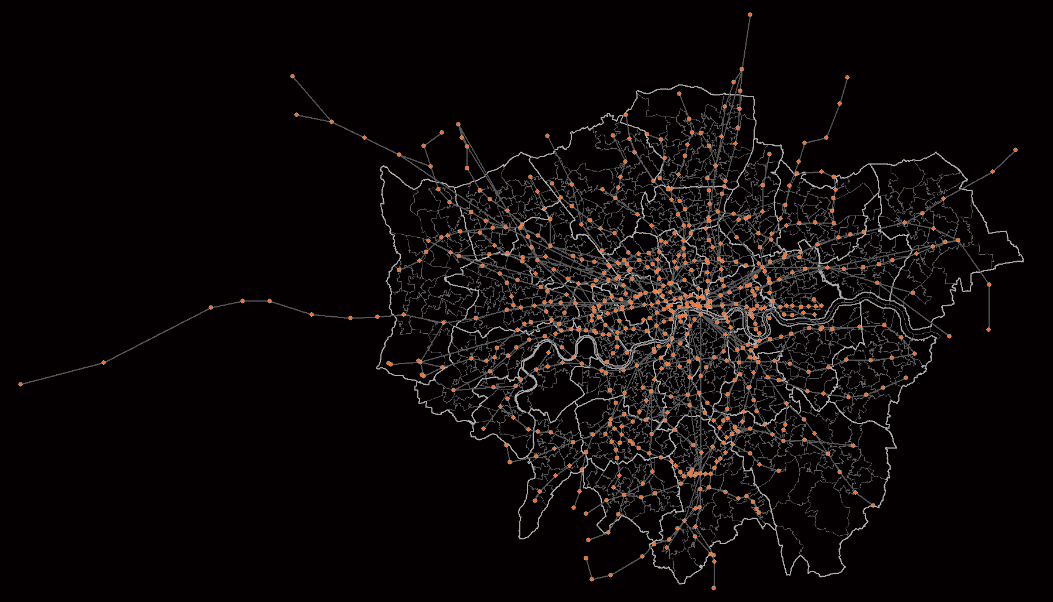
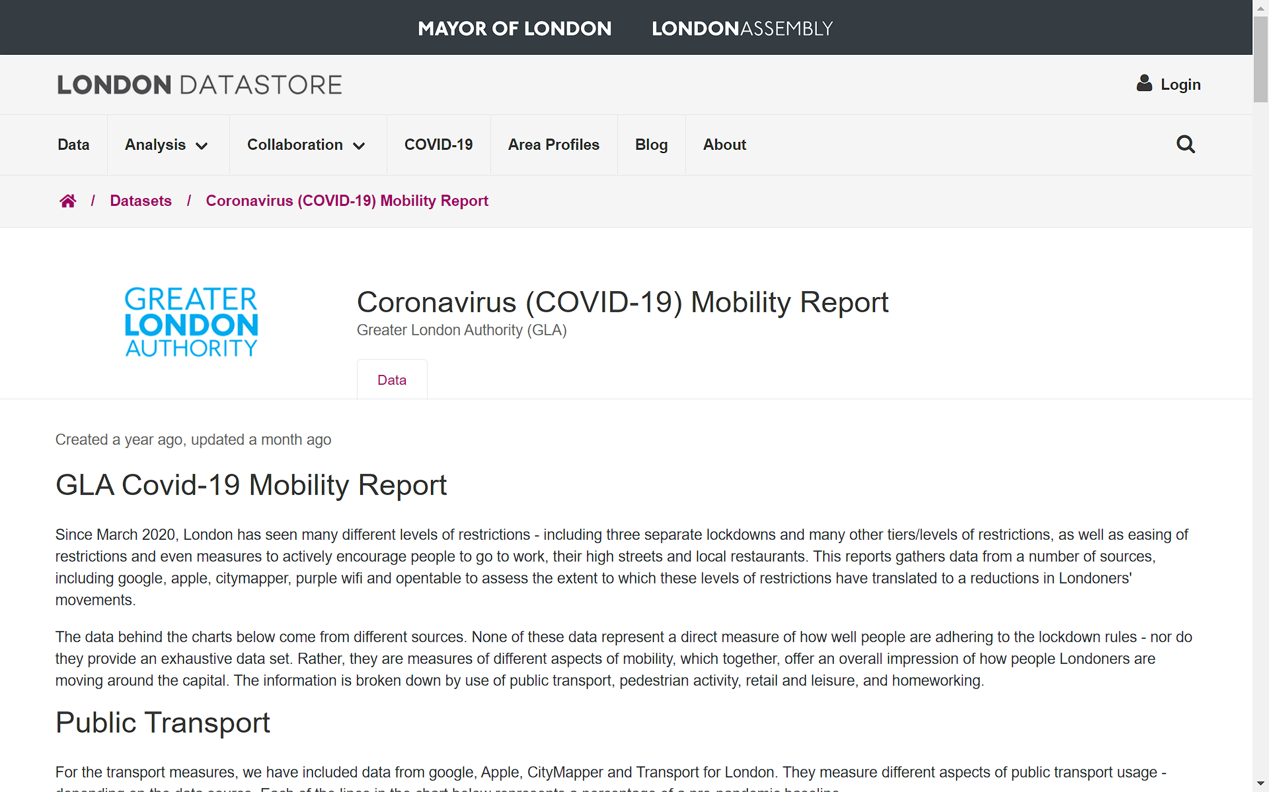
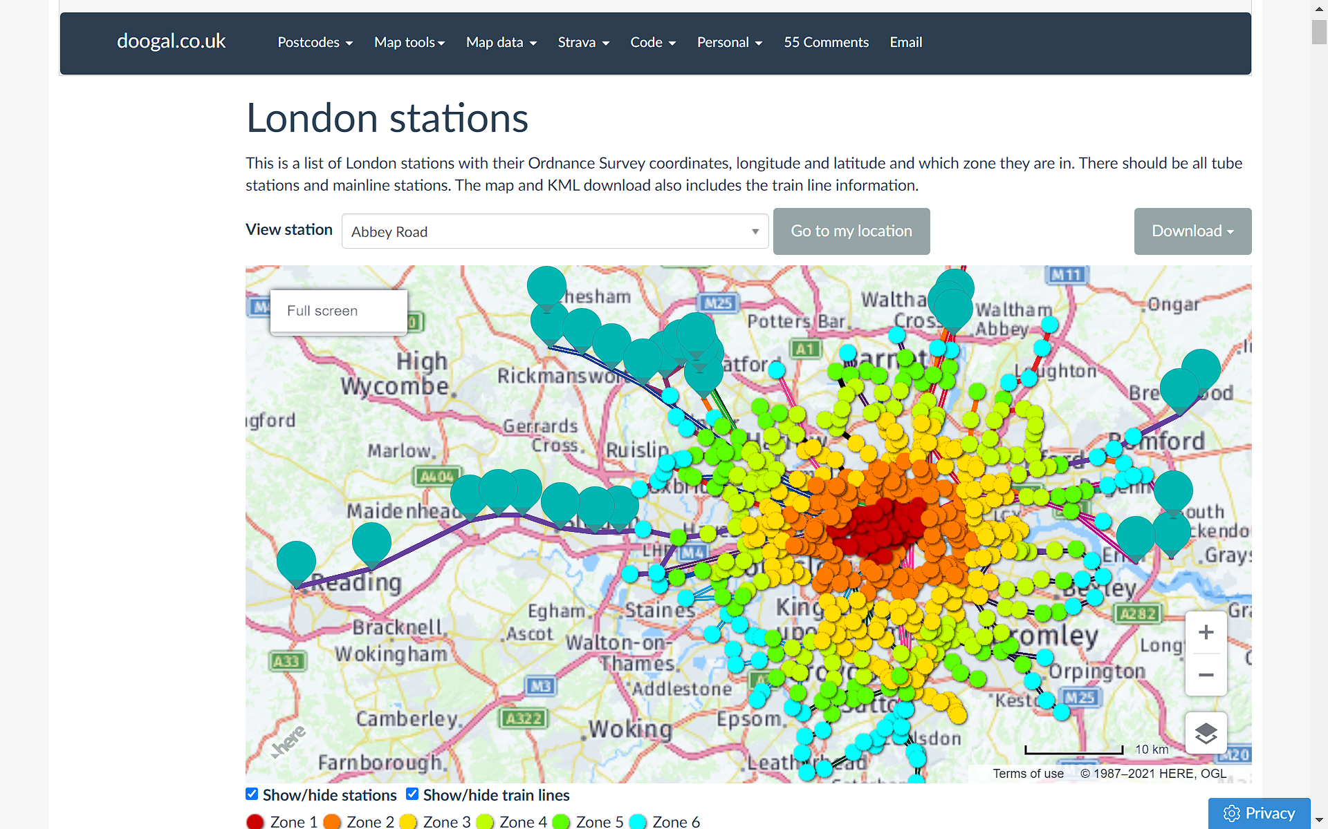
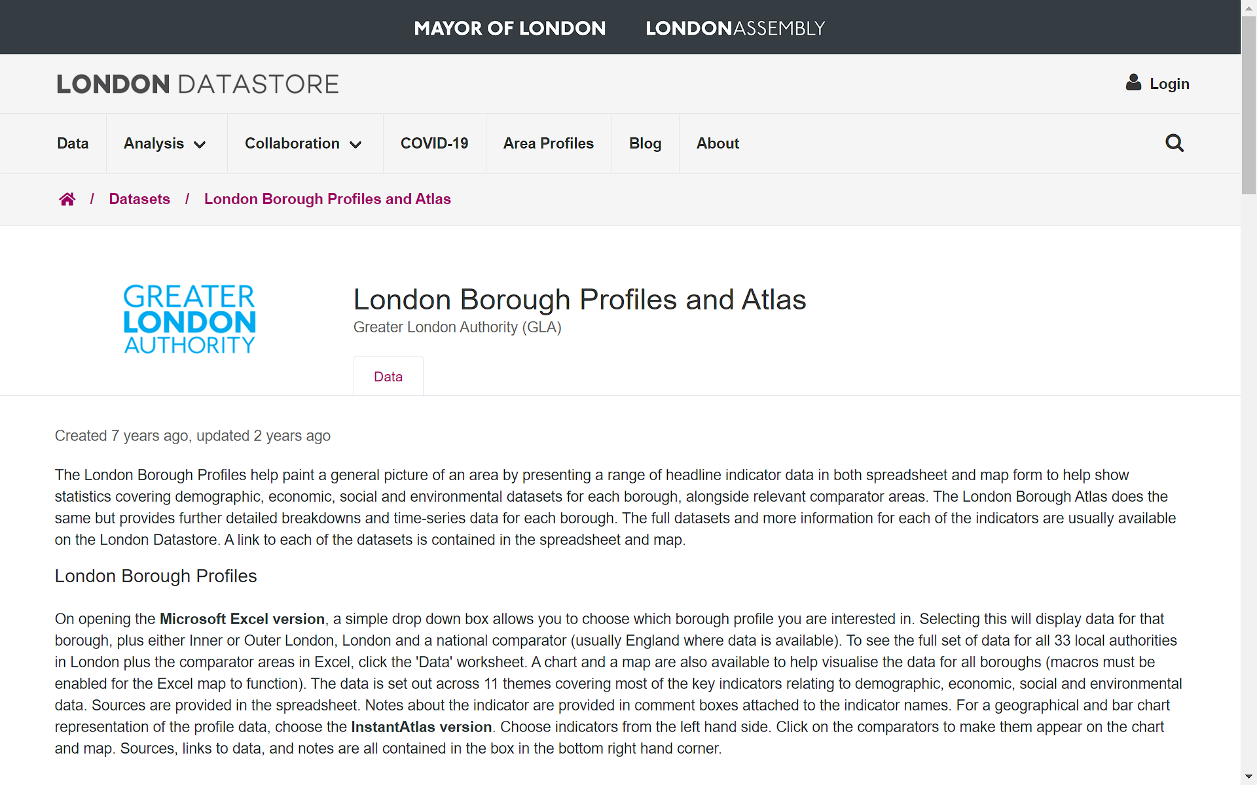
Coronavirus (COVID-19) Mobility Report from GLA
DATA
UNDER CONVID-19
Geological Data
London Underground Lines and Stations (shapefile, doogal)
https://www.doogal.co.uk/london_stations.php
London Borough Profiles (shapefile, GLA)
https://data.london.gov.uk/dataset/london-borough-profiles
Coronavirus (COVID-19) Mobility Report from GLA
Notes:
And We also have the geological data including the Underground lines and stations shapefile and the London borough shapefile, both provided by GLA.

Slide 9
DATA
UNDER CONVID-19
Data Prepocessing
Statistical Data
426 stations named with appendixes
NO information about lines or boroughs
Geological Data
662 stations named without appendixes
28 tube lines
33 boroughs
Unify the number, name and location of stations and tube lines with QGIS;
Assign line and borough information to the corresponding stations with Pandas;
Assign station Information to the corresponding tube lines and boroughs with Pandas.
Notes:
The data is not immediately ready for use.
In the statistical data there are 400 stations named with appendixes; but no information about line or borough. In the geological data, there are 600 stations named without appendixes, and 28 tube lines and 33 boroughs.
So we preprocessed the data.
We unified the number, name and location of stations and tube lines in both datasets with QGIS;
We assign line and borough information to the corresponding stations with Pandas;
And we assign station Information to the corresponding tube lines and boroughs with Pandas.
This process is time-consuming.

Slide 10
ANALYSIS
UNDER CONVID-19
Methodology
PROCESSED DATA
ANALYSIS
KEY FINDINGS
Macro Level
Data Visualization;
General trend in public transportation;
Change in Underground journey pattern.
Synchronous decreses in all public transports
… …
Data
About underground journeys
Data Visualization;
Linear Regression;
Geological Analysis.
Medium Level
Journey Changes at Tube Line level;
Journey Changes at Borough level;
COVID-19’s impact on underground journeys at borough level.
No statistical correlation;
Negative spatial correlation;
… …
Data
About Covid-19 Cases
Dynamic Time Warping
(DTW) Clustering.
Micro Level
New changes in Flow Patterns.
New temporal characteristics in the flow at different metro Stations .
?
Notes:
Our analysis is a three-step process based on data about underground journeys and covid-19 cases.
At the macro level, through data visualization ,we demonstrate general trend in public transportation and unique changes in underground journeys;
At the meso level, we use Data Visualization, and Regression, to demonstrate journey changes in tube line level and borough level, and find the covid-19’s impact on underground journeys at borough level.
At the micro level, we use Dynamic Time Warping (DTW) Clustering, to conclude new temporal characteristics in the flow at different metro stations under the COVID-19.
At each stage ,we will have some different fidings.

Slide 11
WEBSITE
UNDER CONVID-19
We will present the website we created live~
Notes:
Here is our intended work devision.

Slide 12
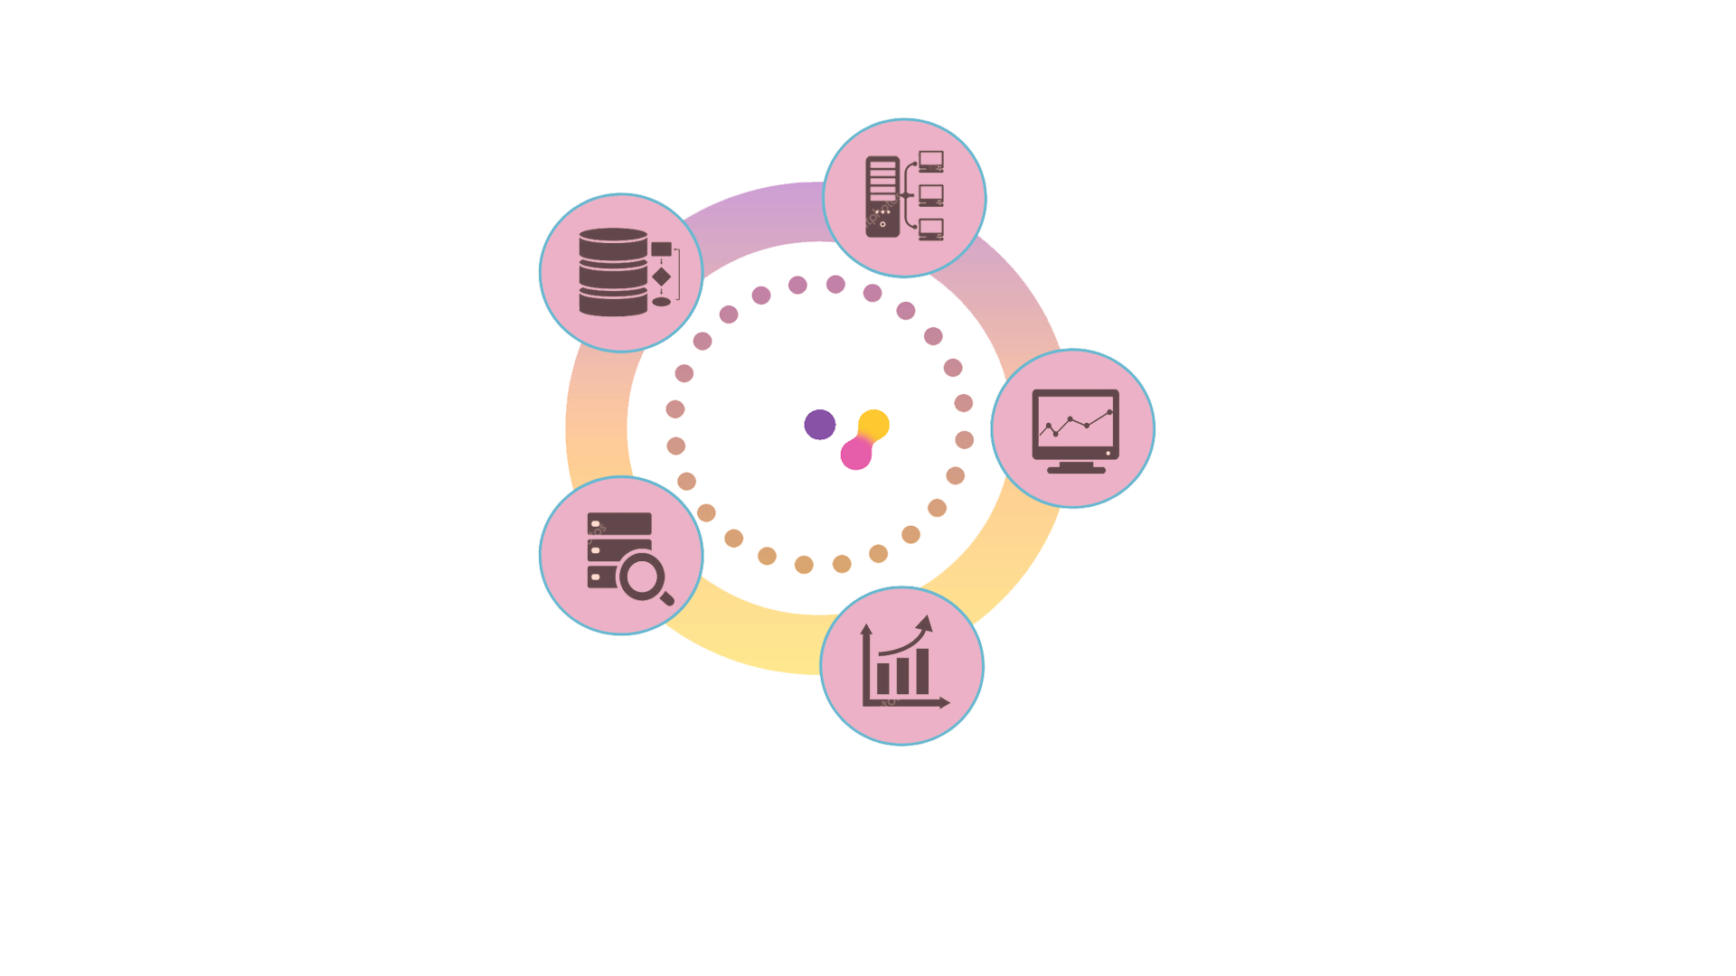
WORK DEVISION
UNDER CONVID-19
Yujue Wang
Website Construction
User Interface Design
Zhiyuan Li
Data Cleaning
Data Analysis
3 in Frontend Development
Website Frame Construction
User Interface Design
2 in Backend Development
Data Cleaning
Data Analysis
Report Communicating
Haocheng Sun
Website Frame Construction
Backend development
Yitong Yue
Website Construction
User Interface Design
Frontend development
Yutong Xia
Data Cleaning
Data Analysis
Notes:
Here is our intended work devision.

Slide 13
LIMITATION
UNDER CONVID-19
We haven’t performed further regression based on geographical correlation between Covid-19 cases and traffic decreases;
The clustering analysis only focuses on the shape of the time series of transport counts, without considering the size of the flow, as the data have been normalized before distance measurement.
Originally planned to add more charts reflecting macro changes and use the number of epidemics as a base map in the map interactive interface.
Notes:
Here is our reflection on limitation which we won,t go into details for the concern of time.
We haven’t performed further regression based on geographical correlation between Covid-19 cases and traffic decreases;
The clustering analysis only focuses on the shape of the time series of transport counts, without considering the size of the flow. So for some stations with few flows throughout the day, their temporal profiles may not be accurate when explained by the description of their clusters.
Originally planned to add more charts reflecting macro changes and use the number of epidemics as a base map in the map interactive interface.

